Slide 1

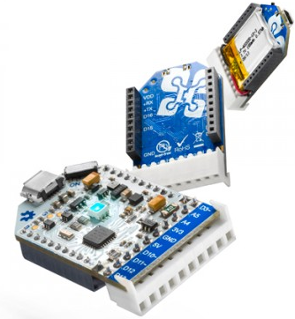

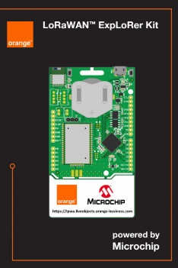

Programming Platform for Internet of Things (IoTs) Applications

Slide 2
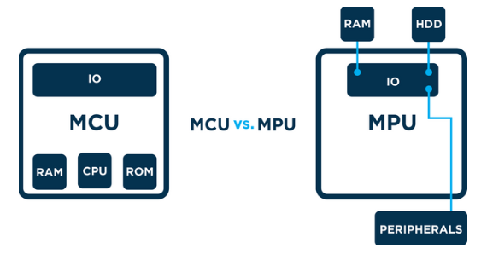

Micro-Controller Platform
Micro-Controller Unit (MCU) contains RAM, ROM and IO
Micro-Processor Unit (MPU) only contains the CPU
System on Chip (SoC) refers to MCUs with a greater number of onboard peripherals and functionality
http://theairboard.cc
http://www.ti.com
http://www.microchip.com

Slide 3

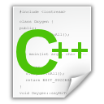
C Language: Header and C++ Files
#include “led.h”
int T_on;
int T_off;
int counter;
void setOn(long duration){
//TODO: set LED on here
}
void setoff(long duration){
//TODO: set LED off here
}
void delay(long duration){
//TODO: set delay here
}
#ifndef __LED_H_
#define __LED_H_
#include <system_lib.h>
#include “user_lib.h”
#include “UserFolder/lib.h”
extern int T_on;
extern int T_off;
void setOn(long duration);
void setoff(long duration);
#endif

Slide 4
C Language: Main File
#include “led.h”
#include “timer.h”
#include “gpio.h”
#include “button.h”
void main(){
initGPIO();
initTimer();
initButton();
initLED();
….
….
while(1){};
}
void timer_isr(){
}
void ext_isr(){
}
Modules/ Libraries are included
LED
Modules/ Libraries are initiated
TIMER
GPIO
System operations are implemented in interrupt functions
BUTTON

Slide 5
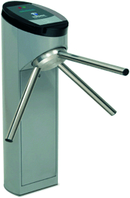
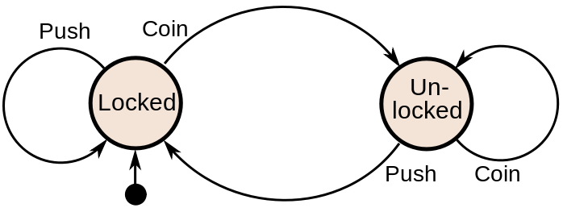
Finite State Machine (FSM)
Finite-State Machine (FSM) or Deterministic Finite Automata (DFA), finite automaton, or simply a state machine, is a mathematical model of computation
Current State | Input | Next State
Locked | Coin | Unlocked
 | Push | Locked
Unlocked | Coin | Unlocked
 | Push | Locked
A turnstile

Slide 6
Finite State Machine Programming
while(1){
switch(status){
case LOCKED: lock_turnstile(); //operation in a state
if(Coin == true) //transition condition
status = UNLOCKED; //next state
break;
case UNLOCKED:
unlock_turnstile(); //operation in a state
if(Push == true) //transition condition
status = LOCKED; //next state
break;
default:
break;
}
}

Slide 7
Example 1
Given an LED turns on for T_on and then turns off for T_off.
Design an DFA for this LED
Implement the DFA in Arduino
digitalWrite(13, HIGH): turn on the LED
digitalWrite(13, LOW): turn off the LED
setTime(duration): set a clock (timer_flag = 0), when the clock is expired, timer_flag = 1; duration is in mili-seconds.

Slide 8
Answer
timer_flag == 1
INIT
LED_ON
LED_OFF
timer_flag == 1
INIT: Set pin 13 to OUTPUT mode, set timer
LED_ON: Turn on the LED
LED_OFF: Turn off the LED

Slide 9
Answer (Arduino Code)
void loop(){
switch(status){
case INIT: pinMode(13, OUTPUT);
setTimer(T_on);
status = LED_ON;
digitalWrite(13, HIGH);
break;
case LED_ON:
if(timer_flag == 1){
status = LED_OFF;
setTimer(T_off);
digitalWrite(13, LOW);
}
break;
case LED_OFF:
if(timer_flag == 1){
status = LED_ON;
setTimer(T_on);
digitalWrite(13, HIGH);
}
break;
default:
break;
}
delay(10);
}
void timer_run(){
if(timer_counter > 0)
timer_counter--;
if(counter_timer == 0)
timer_flag =1;
}
void setTimer(long duration){
timer_counter = duration;
timer_flag = 0;
}

Slide 10
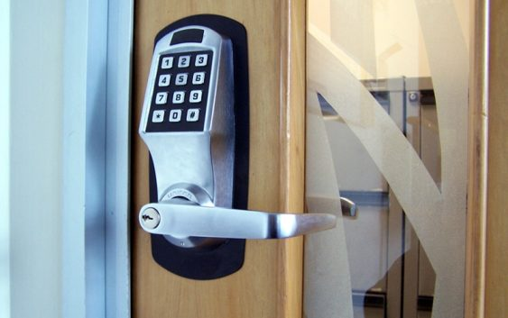
Example 2
Design a smart lock which accepts 4 digits as a secrete code. However, there is a time-out for each digit (e.g. T_out = 5s). After this period, the system is reset

Slide 11
Embedded Platform based on Operating System
Embedded means something that is attached to another thing.
“Any sort of device which includes a programmable computer but itself is not intended to be a general-purpose computer” [Marilyn Wolf]
Embedded system has three components:
Hardware
Real Time Operating System (RTOS)
Software

Slide 12
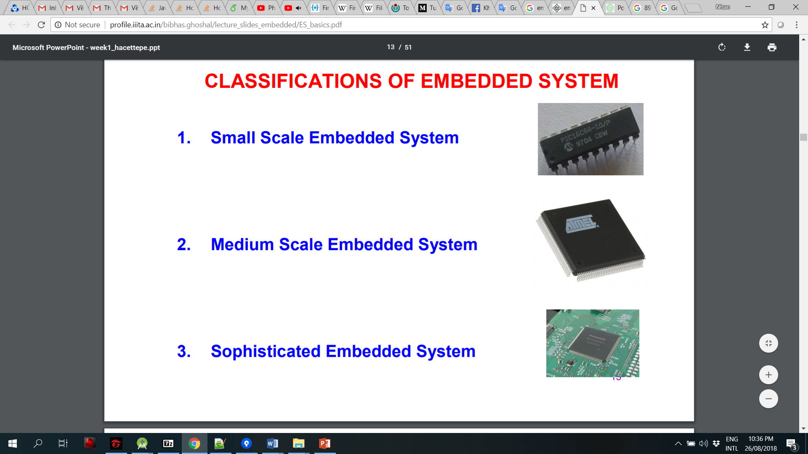
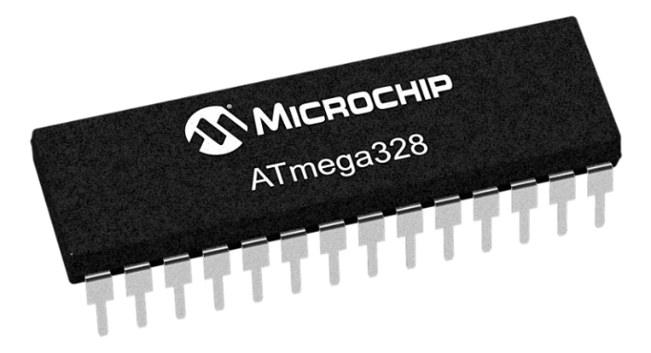
Classification of Embedded System
Small Scale
Medium Scale
Sophisticated Scale

Slide 13
Processor
Processor is the heart of the Embedded Syste
General Purpose processor (GPP)
Microprocessor
Microcontroller
Embedded Processor
Digital Signal Processor
Application Specific System Processor (ASSP)
Multi Processor System using GPPs

Slide 14
Operating System: Linux and Android
Connectivity and UI
Two powerful operating systems used in most of the embedded systems
Wireless connectivity and graphics interface: Android OS
Linux comes with a complex flow and it might be difficult for a beginner to understand it
Power management
Android and Linux supports effective power management compared to real time operating systems
Responsiveness
Cost

Slide 15
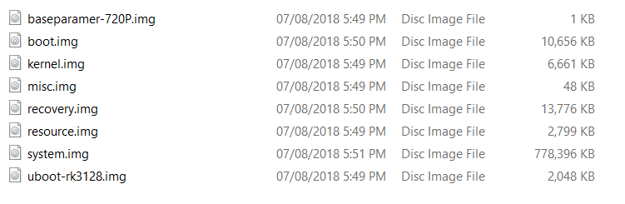
Android Operating System Component

Slide 16
Android Boot File
mkdir /system
mkdir /data 0771 system system
mkdir /cache 0770 system cache
mkdir /config 0500 root root
mkdir /metadata 0770 root root
service yunos_preinstall /system/bin/yunos_preinstall.sh
user root
group root
class main
disabled
oneshot

Slide 17
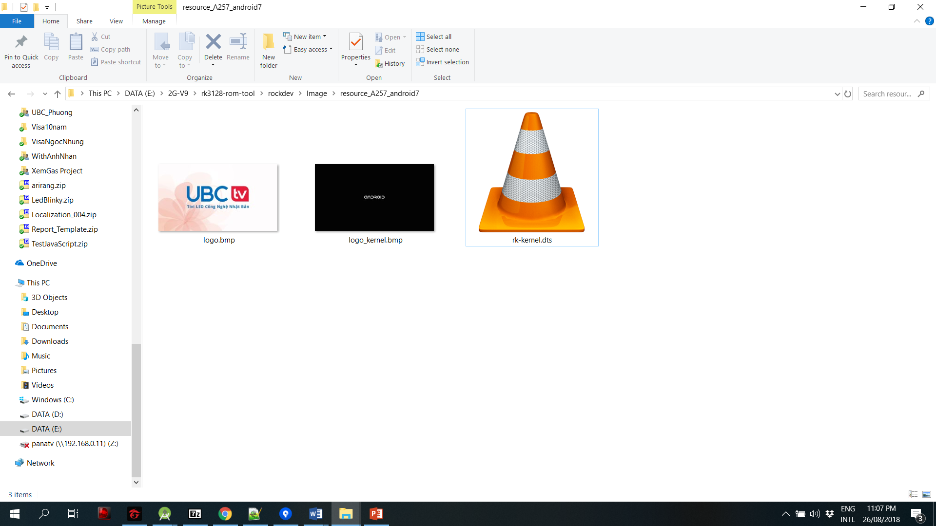
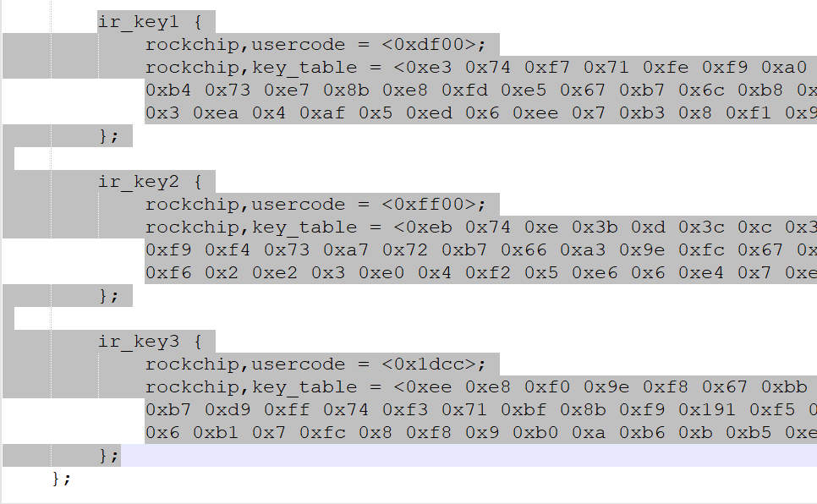
Android Resource File
IR Remote Data

Slide 18
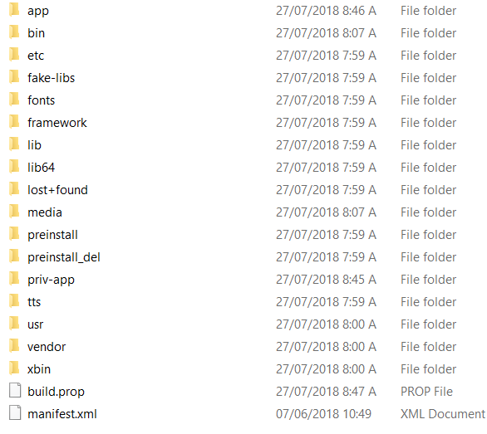
Android System File
System apps
User apps
Launcher apps
Preinstall apps
Libs
KeyLayout
…

Slide 19
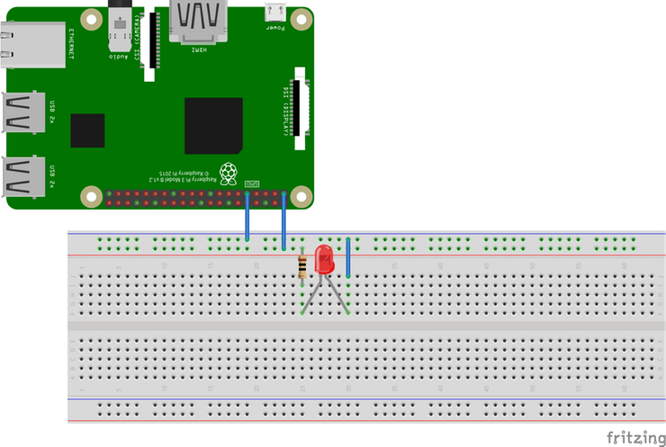
Lab 2: LED Blinky on Android Things
Hardware connection

Slide 20
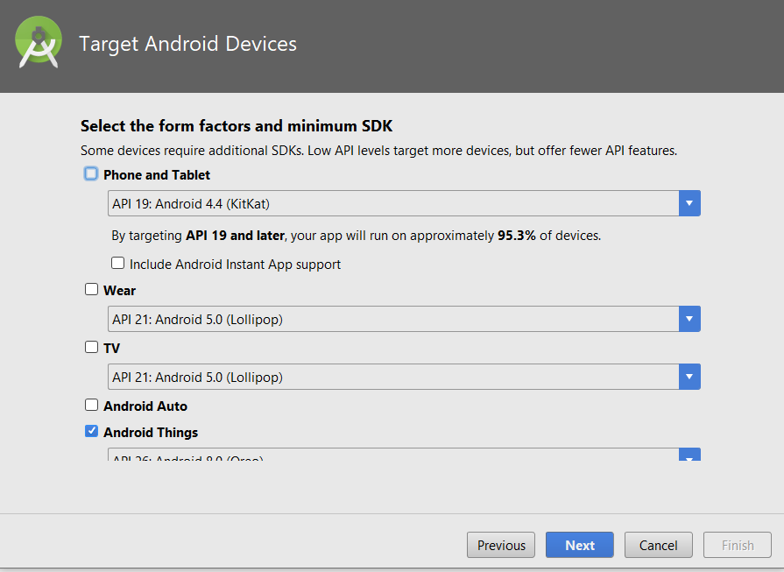
Create an Android Things Project
dependencies { ... compileOnly 'com.google.android.things:androidthings:+' }

Slide 21
Add permission in Android Manifest
<uses-permission android:name="com.google.android.things.permission.
USE_PERIPHERAL_IO" />

Slide 22
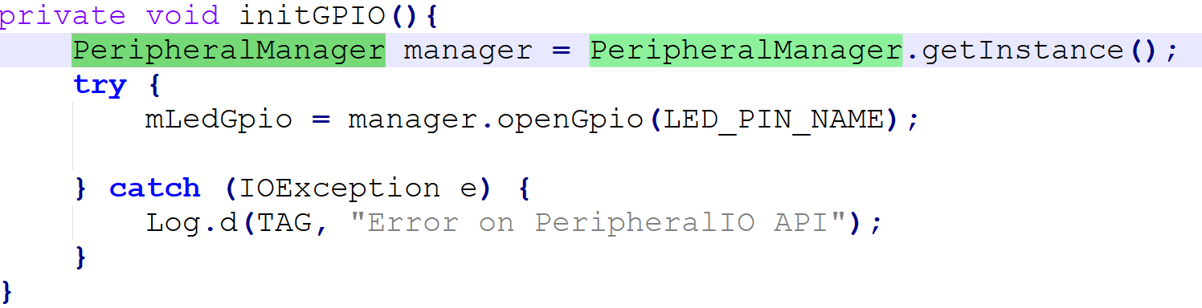
MainActivity.java
Step 1: Declare a pin name wired to LED
private static final String LED_PIN_NAME = "BCM26";
Step 2: Implement initGPIO function
Step 3: Call initGPIO() on OnCreate()

Slide 23
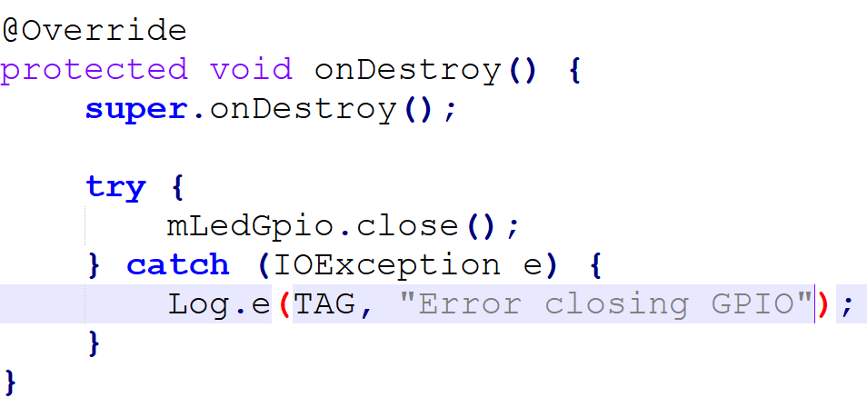
MainActivity.java
Step 4: Release the pin when the app is closed

Slide 24
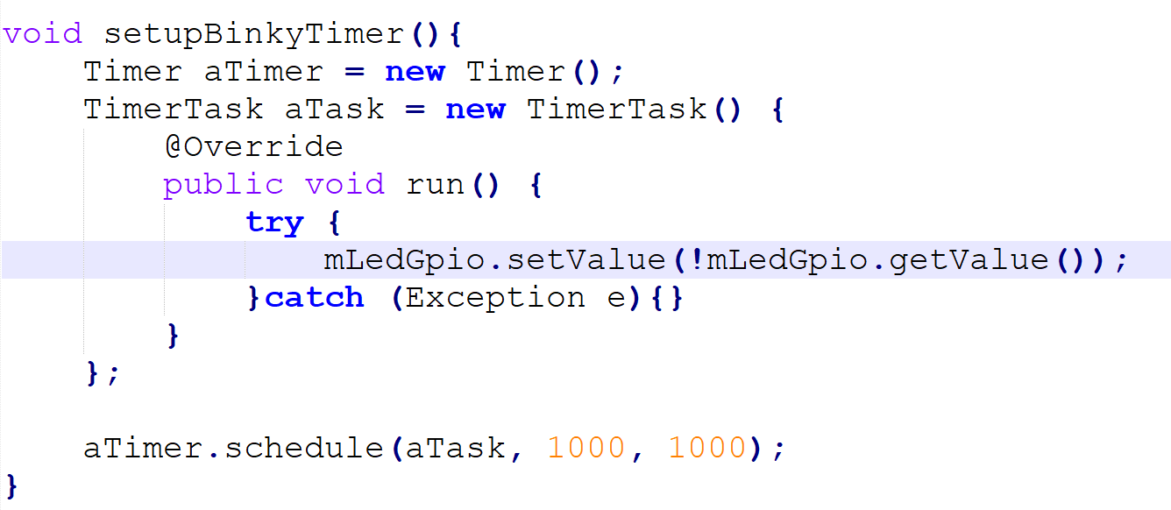
MainActivity.java
Step 5: Create a Timer
Step 6: Call this function on OnCreate()

Slide 25
Exercise
Implement a Light Traffic System

